Slide 1

Advancing Cold Chain: AI-Driven Adaptive Storage
Revolutionising harvest Preservation with Smart Technology

Slide 2
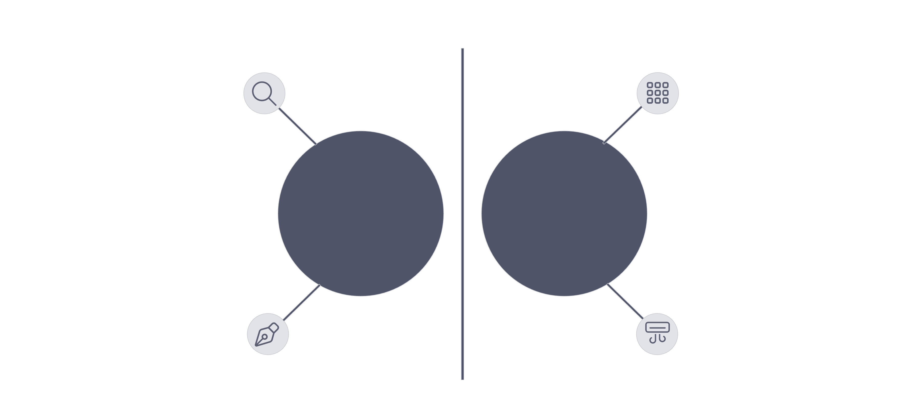








Literature Review
Prior research highlights the limitations of conventional cold storage and the emerging potential of smart technologies. Integrating AI for precise environmental control remains an underexplored frontier in postharvest systems.
Conventional Cold Storages
Bulk cooling leads to uneven airflow and localised spoilage.
IoT Monitoring
Uneven airflow
Partitioned zones
Used for monitoring, but lacks real-time actuation and dynamic response.
Gas Management
Ethylene and CO₂ accumulation are critical, but mostly managed at the chamber level, not granularly.
AI in Greenhouses
Conventional Cold Storage
Proposed Adaptive System
AI-based adaptive control is explored in greenhouses but largely absent in cold storage applications.
Spoiled produce
Sensors + AI control

Slide 3










Research Gaps
Monitoring-Only IoT
Tray-Level Variations Ignored
Current IoT solutions provide data but lack real-time autonomous actuation capabilities.
Uniform cooling fails to address microclimates and specific needs at the individual tray level.
Chamber-Scale Gas Scrubbing
Ethylene/CO₂ management operates at the chamber level, not targeted tray-specifically.
Absence of AI Control
No comprehensive AI-driven adaptive cooling system exists for precise tray-level control.
Limited Energy Optimisation
Energy-saving methods focus on compressors rather than optimised airflow dynamics.

Slide 4








Objectives
Our project aims to bridge these gaps by developing a sophisticated, AI-driven adaptive cold storage system for enhanced postharvest preservation.
Tray-Level Sensing
Adaptive Airflow Control
Closed-Loop Gas Filtration
Implement precise sensing for temperature, humidity, CO₂, ethylene, and produce weight at each tray.
Develop and integrate dynamic airflow control using smart rack valves and individual tray fans.
Design and integrate a closed-loop system for efficient ethylene and CO₂ removal.
Real-Time AI Decision-Making
Data Logging & Dashboards
Utilise an offline LLM for intelligent, real-time environmental adjustments.
Establish MongoDB-based logging and interactive dashboards for comprehensive monitoring and analysis.

Slide 5


Hardware & Software Specifications
Our system leverages a robust combination of microcontrollers, sensors, and modern software frameworks to achieve intelligent cold chain management.
Hardware Components
Software Stack
Microcontrollers: Arduino Uno/Mega for data acquisition and control.
Backend: Python with Flask for API and logic, PySerial for Arduino communication.
Sensors: DHT22 (Temp/Humid), CO₂ sensor, Ethylene sensor, Load cell + HX711 (weight).
Database: MongoDB for flexible, scalable data storage.
Actuators: DC fans for localised airflow, Solenoid valves for gas management.
AI Agent: LangChain + Ollama for offline LLM integration and decision-making.
Power & Structure: Reliable Power supply, Custom rack + trays for modularity.
Visualisation: Dash/Plotly for interactive charts, HTML/CSS for responsive dashboards.
Firmware: Arduino IDE for microcontroller programming.

Slide 6
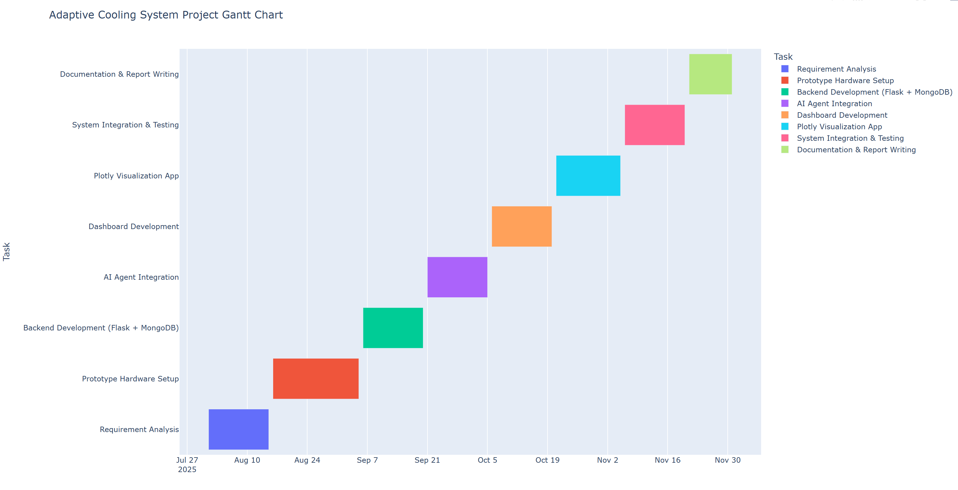
Gantt Chart & Work Breakdown Structure
Our project follows a structured approach, from initial requirements gathering to final validation and reporting, ensuring systematic development.

Slide 7
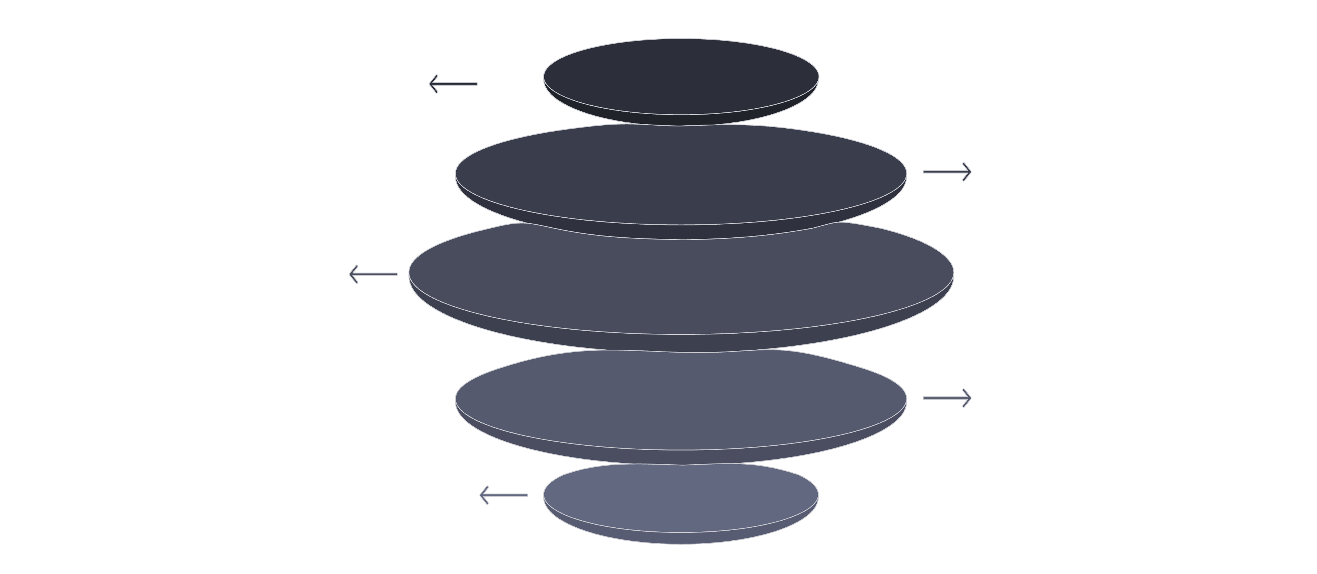
Requirement Analysis (SRS)
The System Requirements Specification (SRS) outlines both the functional and non-functional aspects, defining the system's capabilities and performance criteria.
Functional Requirements
Non-Functional Requirements
Tray-level environmental sensing.
Latency: Decision-to-actuation <2s.
AI-driven decision-making for environmental control.
Scalability: Support for multiple racks/trays.
Automated actuation of fans and valves.
Reliability: 24/7 operation with fault tolerance.
Real-time data logging and storage.
Energy Efficiency: Optimised power consumption.
Interactive data visualisation and manual control.
Sensors
Collect tray environmental data
Arduino
Aggregate and preprocess signals
Flask Backend
Receive and expose API endpoints
MongoDB
Store time-series and metadata
Dashboards
Visualize analytics and alerts

Slide 8

Workflow Model
The system's workflow demonstrates a closed-loop control mechanism, from data acquisition to intelligent actuation and continuous monitoring.
Sensors
Arduino
Backend
AI Agent

Slide 9
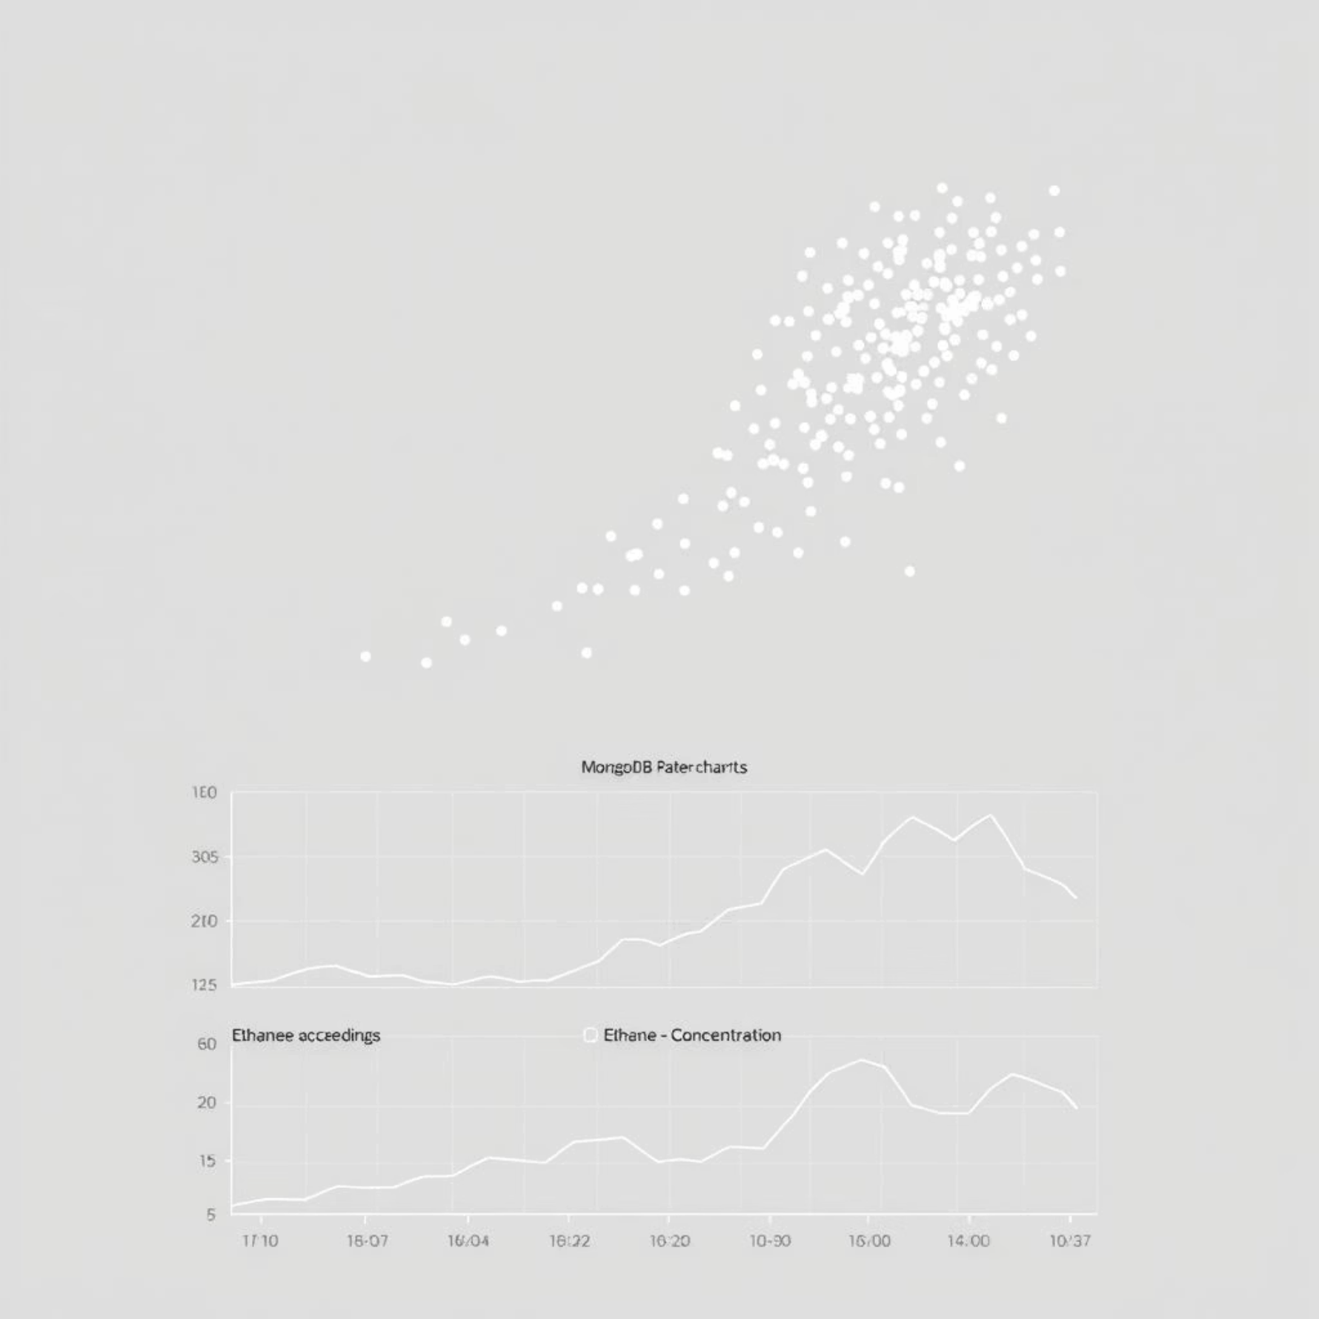
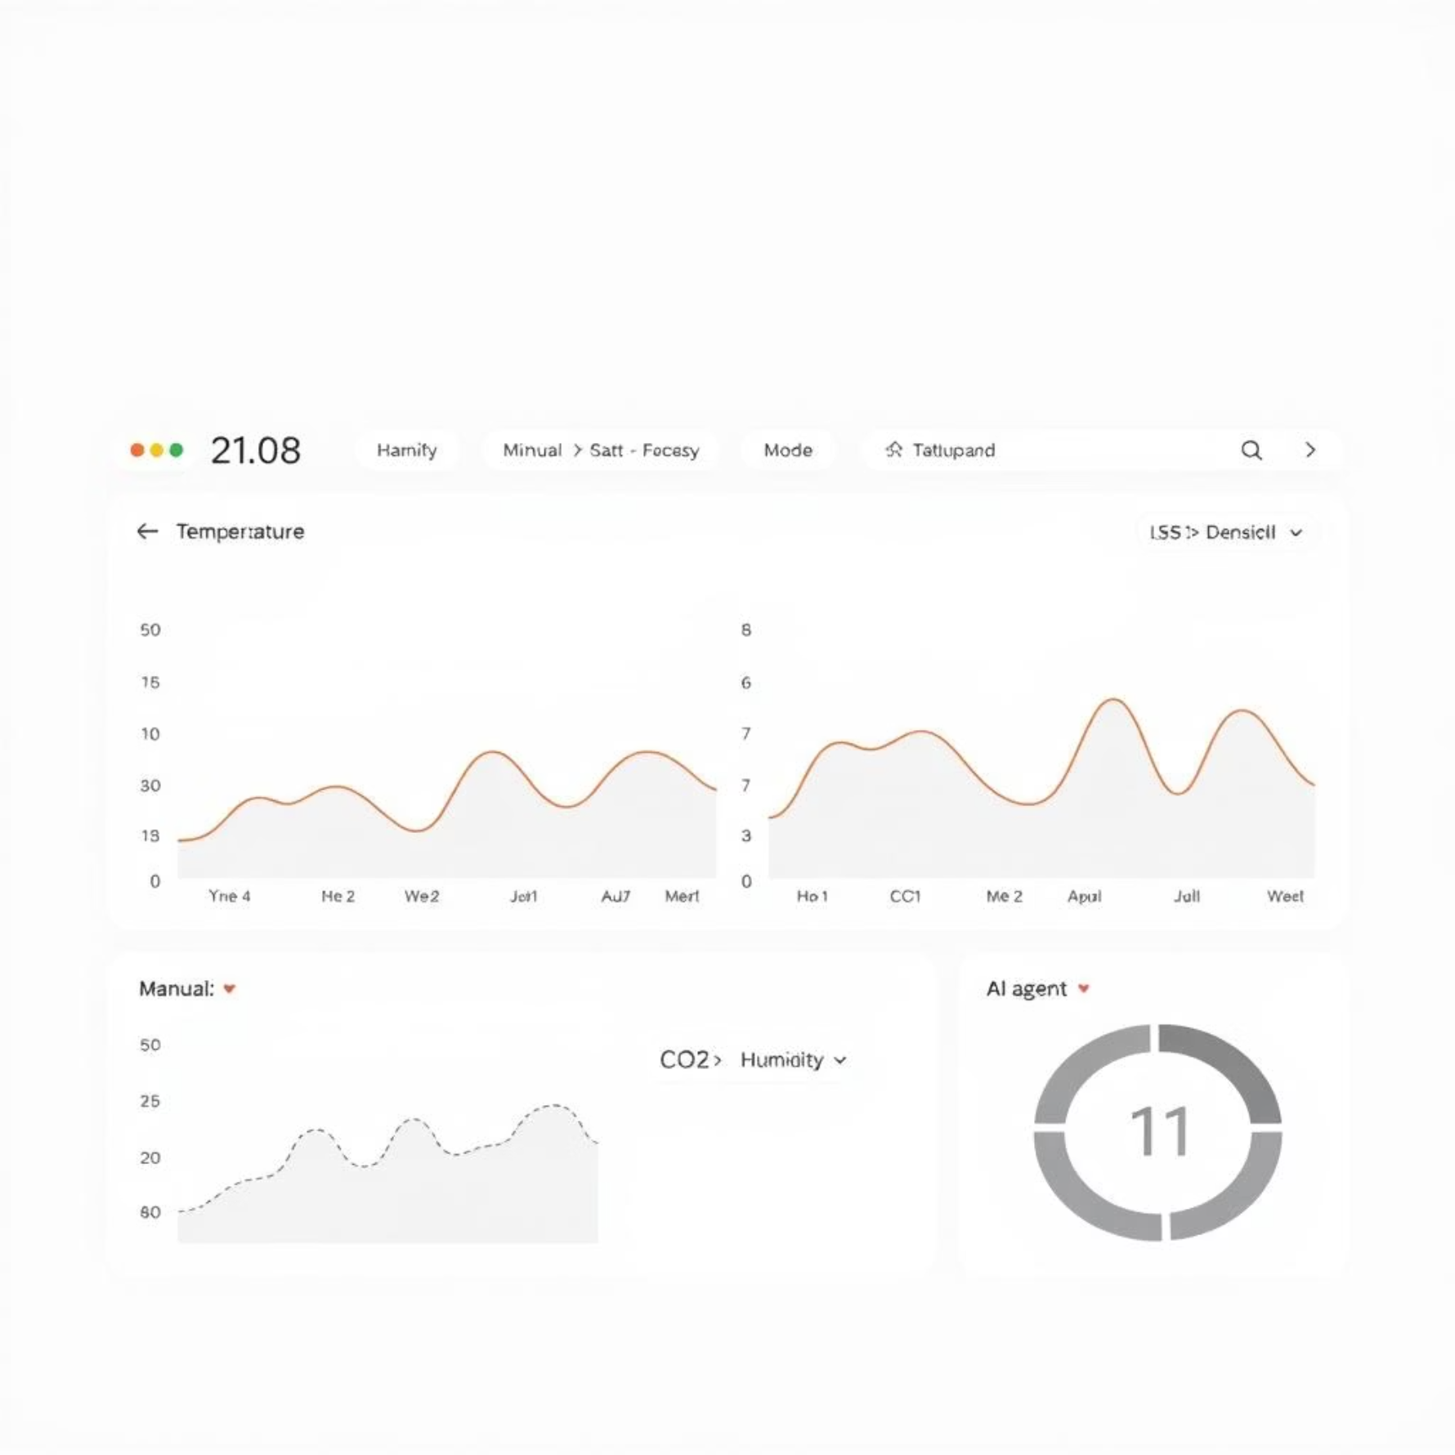
Module Design & Implementation
Significant progress has been made on core system modules, with the prototype demonstrating feasibility and key functionalities. Remaining work focuses on validation with real-world conditions.
Completed Modules
Pending Modules & Future Work
Rack + tray prototype assembly.
Extensive produce testing and validation.
Sensor interfacing and calibration.
Validation with real-world postharvest data.
Serial communication established (Arduino-Python).
Detailed energy benchmarking and optimisation.
Flask backend for data processing and API.
Long-term reliability and stability testing.
MongoDB logging and data persistence.
AI agent integration (offline LLM).
Admin dashboard with manual/agent control modes.
Plotly visualisation application for data trends.

Slide 10


Conclusion & Next Steps
The prototype successfully demonstrates the feasibility of tray-level adaptive cooling, paving the way for significant advancements in postharvest technology.
Expected Outcomes
Feasibility Confirmed
Anticipated benefits include substantial energy savings, extended produce shelf life, and superior monitoring capabilities.
The prototype proves that tray-level adaptive cooling with AI integration is achievable and effective.
Scaling & Evaluation
Real-Produce Testing
Expand the system to larger racks and conduct comprehensive performance evaluations and benchmarking.
Conduct rigorous testing with various types of produce to validate performance under diverse conditions.

